Slide 1

NETWORK MODELS

Slide 2
OSI MODEL
An ISO standard that covers all aspects of network communications is the Open Systems Interconnection model. ISO is the organization. OSI is the model
An open system is a set of protocols that allows any two different systems to communicate regardless of their underlying architecture. The purpose of the OSI model is to show how to facilitate communication between different systems without requiring changes to the logic of the underlying hardware and software. The OSI model is not a protocol; it is a model for understanding and designing a network architecture that is flexible, robust, and interoperable.
The OSI model is a layered framework for the design of network systems that allows communication between all types of computer systems. It consists of seven separate but related layers, each of which defines a part of the process of moving information across a network

Slide 3
Layered Architecture
The OSI model is composed of seven ordered layers: physical (layer 1), data link (layer 2), network (layer 3), transport (layer 4), session (layer 5), presentation (layer 6), and application (layer 7). Each layer defines a family of functions distinct from those of the other layers Most importantly, the OSI model allows complete interoperability between otherwise incompatible systems.
Within a single machine, each layer calls upon the services of the layer just below it. Layer 3, for example, uses the services provided by layer 2 and provides services for layer 4. Between machines, layer x on one machine communicates with layer x on another machine. This communication is governed by an agreed-upon series of rules and conventions called protocols. The processes on each machine that communicate at a given layer are called peer-to-peer processes. Communication between machines is therefore a peer-to-peer process using the protocols appropriate to a given layer.
Interfaces Between Layers
The passing of the data and network information down through the layers of the sending device and back up through the layers of the receiving device is made possible by an interface between each pair of adjacent layers. Each interface defines the information and services a layer must provide for the layer above it. Well-defined interfaces and layer functions provide modularity to a network.

Slide 4
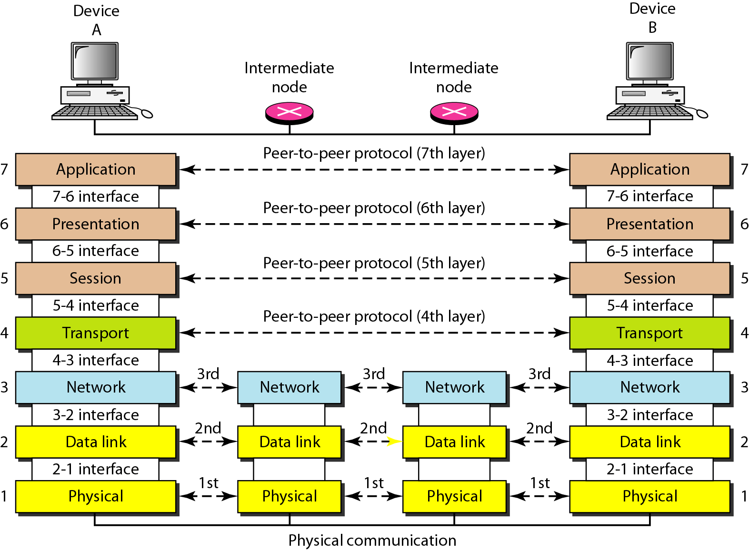
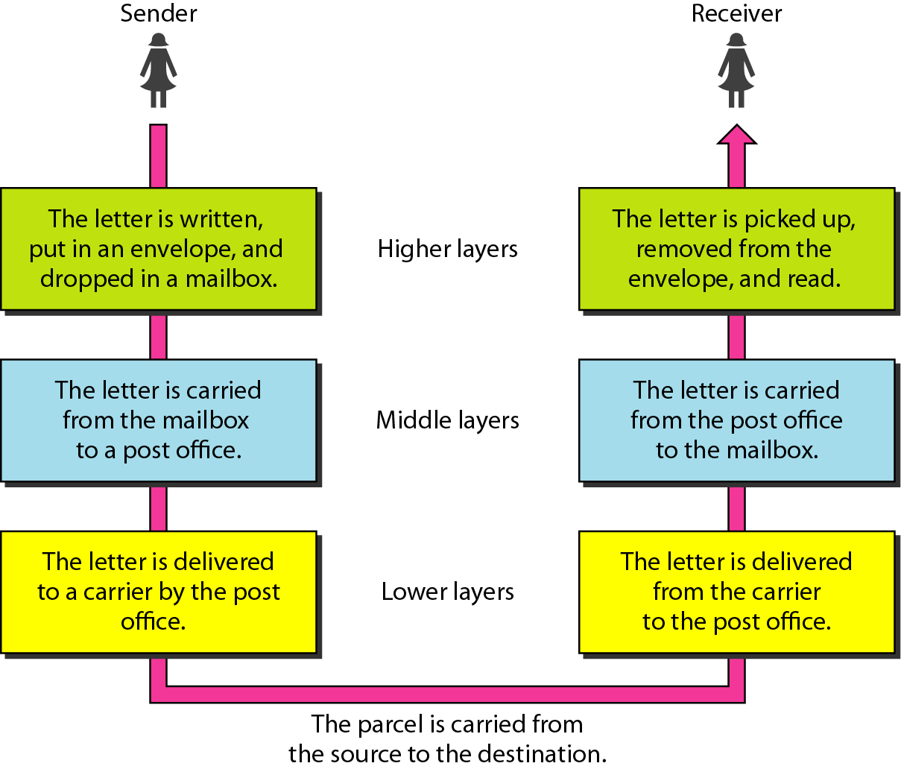

Slide 5
Layered Architecture
The seven layers can be thought of as belonging to three subgroups. Layers I, 2, and 3 -physical, data link, and network-are the network support layers; they deal with the physical aspects of moving data from one device to another (such as electrical specifications, physical connections, physical addressing, and transport timing and reliability).
Layers 5, 6, and 7 -session, presentation, and application-can be thought of as the user support layers; they allow interoperability among unrelated software systems. Layer 4, the transport layer, links the two subgroups and ensures that what the lower layers have transmitted is in a form that the upper layers can use.
The process starts at layer 7 (the application layer), then moves from layer to layer in descending, sequential order. At each layer, a header, or possibly a trailer, can be added to the data unit. Commonly, the trailer is added only at layer 2. When the formatted data unit passes through the physical layer (layer 1), it is changed into an electromagnetic signal and transported along a physical link.
Upon reaching its destination, the signal passes into layer 1 and is transformed back into digital form. As each block of data reaches the next higher layer, the headers and trailers attached to it at the corresponding sending layer are removed, and actions appropriate to that layer are taken. By the time it reaches layer 7, the message is again in a form appropriate to the application and is made available to the recipient.
-Please Do Not Touch Steve’s Pet Alligator

Slide 6
Physical Layer
The physical layer is responsible for movements o individual bits from one hop (node) to the next. The physical layer coordinates the functions required to carry a bit stream over a physical medium. It deals with the mechanical and electrical specifications of the interface and transmission medium. It also defines the procedures and functions that physical devices and inter. Following are the various functions performed by the Physical layer of the OSI model.
Representation of Bits: Data in this layer consists of stream of bits. The bits must be encoded into signals for transmission. It defines the type of encoding i.e. how 0's and 1's are changed to signal.
Data Rate: This layer defines the rate of transmission which is the number of bits per second. Defines duration of bits
Synchronization: It deals with the synchronization of the transmitter and receiver. The sender and receiver are synchronized at bit level.
Interface: The physical layer defines the transmission interface between devices and transmission medium.
Line Configuration: This layer connects devices with the medium: Point to Point configuration and Multipoint configuration.
Physical Topologies: Devices must be connected using the following topologies: Mesh, Star, Ring and Bus.
Transmission Modes: Physical Layer defines the direction of transmission between two devices: Simplex, Half Duplex, Full Duplex.

Slide 7
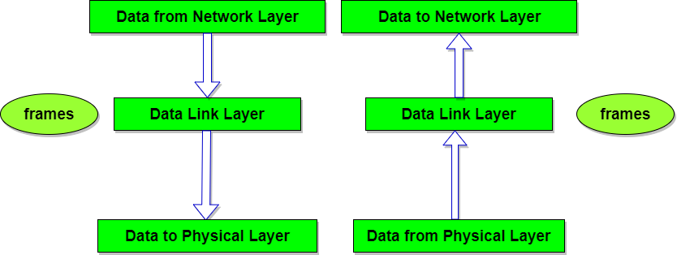
Data link Layer
The data link layer is responsible for moving frames from one hop (node) to the next. Node-to node delivery
Other responsibilities of the data link layer include the following:
Framing: Frames are dividing the streams of bits received from the network layer into manageable data units. This division of stream of bits is done by Data Link Layer.
Physical Addressing: The Data Link layer adds a header to the frame in order to define physical address of the sender or receiver of the frame, if the frames are to be distributed to different systems on the network it is the address of the device that connects the system.
Flow Control: A flow control mechanism to avoid a fast transmitter from running a slow receiver by buffering the extra bit is provided by flow control. This prevents traffic jam(over whelming) at the receiver side.
Error Control: Error control is achieved by adding a trailer at the end of the frame to detect and retransmit damaged frames.Data Link Layers adds mechanism to prevent duplication of frames.
Access Control: Protocols of this layer determine which of the devices has control over the link at any given time, when two or more devices are connected to the same link.

Slide 8
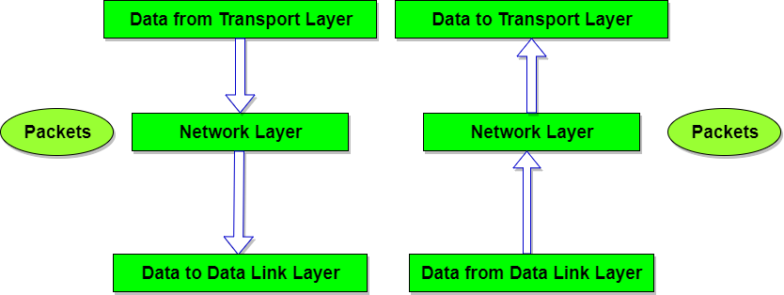
NETWORK LAYER
The network layer is responsible for the source-to-destination delivery of a packet, possibly across multiple networks (links). Whereas the data link layer oversees the delivery of the packet between two systems on the same network (links), the network layer ensures that each packet gets from its point of origin to its final destination.
If two systems are connected to the same link, there is usually no need for a net work layer. However, if the two systems are attached to different networks (links) with connecting devices between the networks (links), there is often a need for the network layer to accomplish source-to-destination delivery.
Logical addressing -The physical addressing implemented by the data link layer handles the addressing problem locally. If a packet passes the network boundary, we need another addressing system to help distinguish the source and destination systems. The network layer adds a header to the packet coming from the upper layer that, among other things, includes the logical addresses of the sender and receiver. It translates logical network address into physical address. Concerned with circuit, message or packet switching.
Routing- When independent networks or links are connected to create intenetworks (network of networks) or a large network, the connecting devices (called routers or switches) route or switch the packets to their final destination. One of the functions of the network layer is to provide this mechanism. Routers and gateways operate in the network layer. Mechanism is provided by Network Layer for routing the packets to final destination.
Congestion control

Slide 9

TRANSPORT LAYER PROTOCOL
The transport layer is responsible for process-to-process delivery of the entire message. A process is an application program running on a host. Whereas the network layer oversees source-to-destination delivery of individual packets, it does not recognize any relationship between those packets. The transport layer is responsible for the delivery of a message from one process to another.
Service Point Addressing: Transport Layer header includes service point address which is port address. This layer gets the message to the correct process on the computer unlike Network Layer, which gets each packet to the correct computer. Delivery means fro a specific process to another specific process(running program)
Segmentation and Reassembling: A message is divided into segments; each segment contains sequence number, which enables this layer in reassembling the message. Message is reassembled correctly upon arrival at the destination and replaces packets which were lost in transmission.
Connection Control: It includes 2 types:
Connectionless Transport Layer : Each segment is considered as an independent packet and delivered to the transport layer at the destination machine.
Connection Oriented Transport Layer : Before delivering packets, connection is made with transport layer at the destination machine.
Flow Control: In this layer, flow control is performed end to end.
Error Control: Error Control is performed end to end in this layer to ensure that the complete message arrives at the receiving transport layer without any error. Error Correction is done through retransmission.

Slide 10
SESSION LAYER
The services provided by the first three layers (physical, data link, and network) are not sufficient for some processes. The session layer is the network dialog controller. It establishes, maintains, and synchronizes the interaction among communicating systems.
The session layer is responsible for dialog control and synchronization.
Dialog Control : This layer allows two systems to enter into a dialog.two systems to start communication with each other in half-duplex or full-duplex.
Token Management: This layer prevents two parties from attempting the same critical operation at the same time.
Synchronization : This layer allows a process to add checkpoints (synchronization points )into stream of data. Example: If a system is sending a file of 800 pages, adding checkpoints after every 50 pages is recommended. This ensures that 50 page unit is successfully received and acknowledged. This is beneficial at the time of crash as if a crash happens at page number 110; there is no need to retransmit 1 to100 pages.

Slide 11
PRESENTATION LAYER
Functions of Presentation Layer
Translation: Before being transmitted, information in the form of characters and numbers should be changed to bit streams. The presentation layer is responsible for interoperability between encoding methods as different computers use different encoding methods. It translates data between the formats the network requires and the format the computer. Changes sender dependent format into common format.
Encryption: It carries out encryption at the transmitter and decryption at the receiver.
Encryption means that the sender transforms the orginal information to another form and decryption reverses it to orginal form
Compression: It carries out data compression to reduce the bandwidth of the data to be transmitted. The primary role of Data compression is to reduce the number of bits to be 0transmitted. It is important in transmitting multimedia such as audio, video, text etc.
The primary goal of this layer is to take care of the syntax and semantics of the information exchanged between two communicating systems. Presentation layer takes care that the data is sent in such a way that the receiver will understand the information(data) and will be able to use the data. Languages(syntax) can be different of the two communicating systems. Under this condition presentation layer plays a role translator.

Slide 12
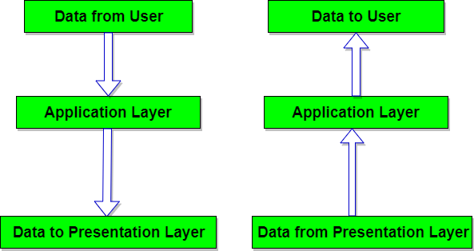
APPLICATION LAYER
Functions of Application Layer
Mail Services: This layer provides the basis for E-mail forwarding and storage.
Network Virtual Terminal: It allows a user to log on to a remote host. The application creates software emulation of a terminal at the remote host. User's computer talks to the software terminal which in turn talks to the host and vice versa. Then the remote host believes it is communicating with one of its own terminals and allows user to log on.
Directory Services: This layer provides access for global information about various services.
File Transfer, Access and Management (FTAM): It is a standard mechanism to access files and manages it. Users can access files in a remote computer and manage it. They can also retrieve files from a remote computer.

Slide 13
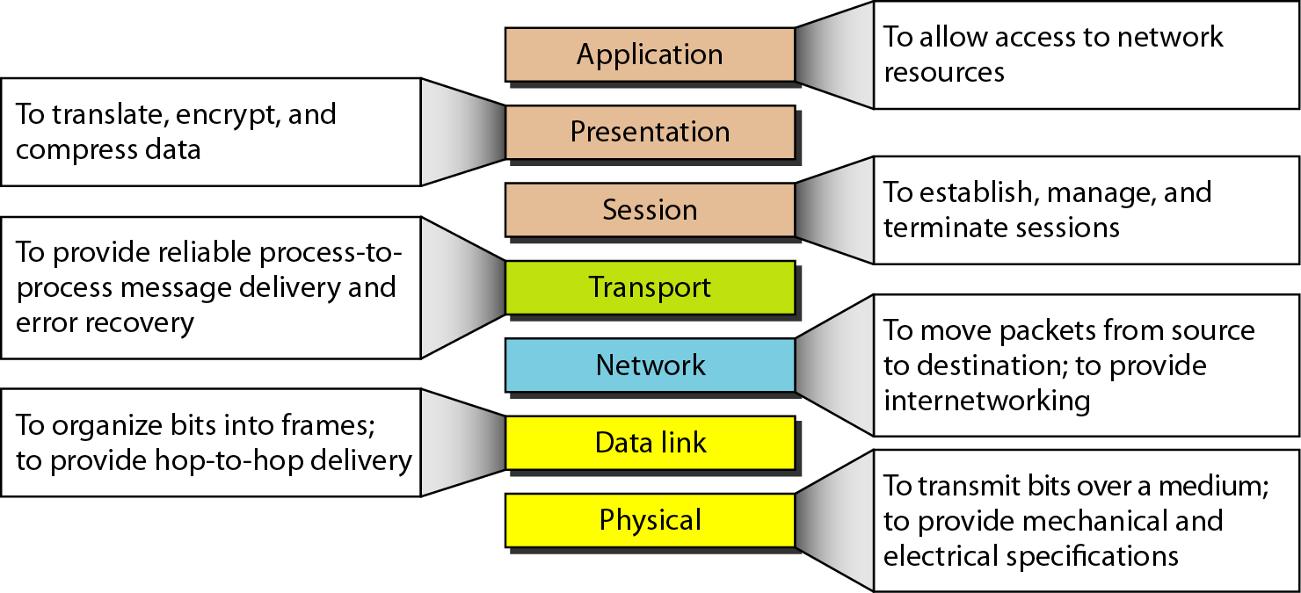
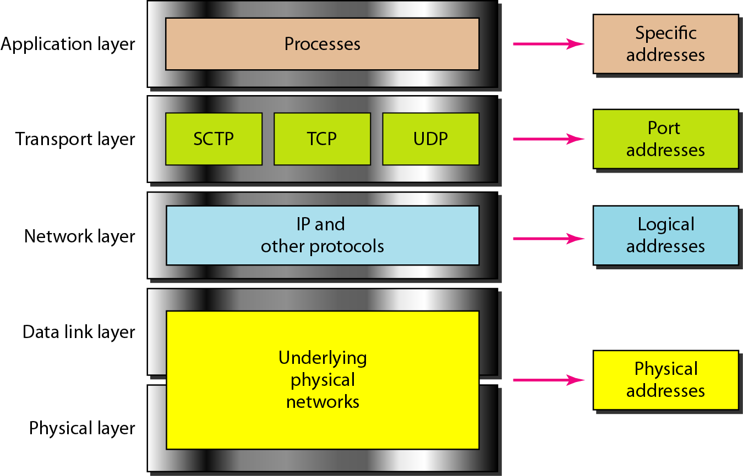
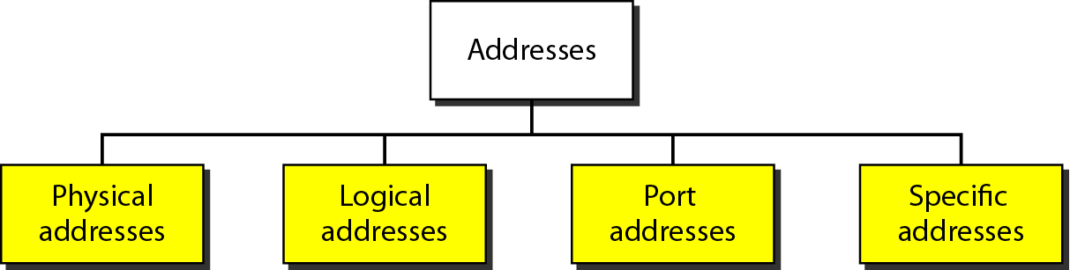

Slide 14
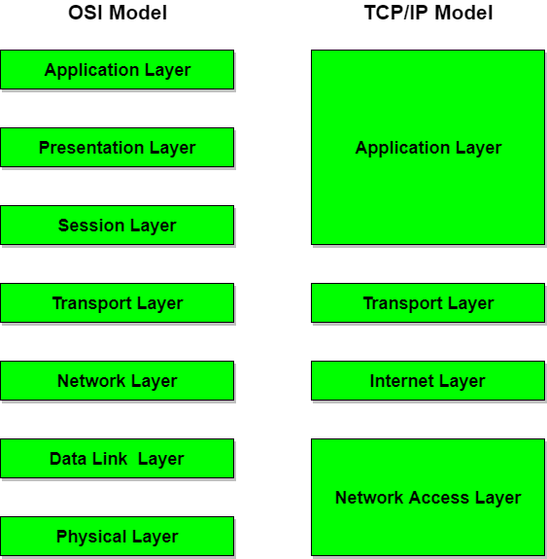
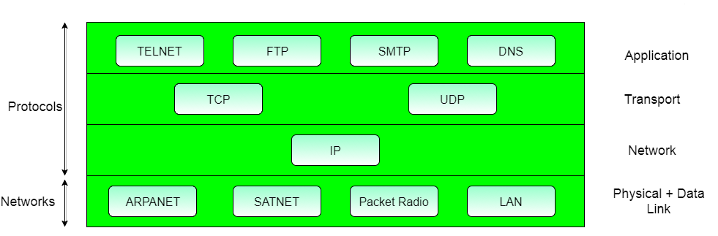
TCP/IP PROTOCOL SUITE
However, when TCP/IP is compared to OSI, we can say that the host-to-network layer is equivalent to the combination of the physical and data link layers.
The internet layer is equivalent to the network layer
The application layer is roughly doing the job of the session, presentation, and application layers with the transport layer in TCPIIP taking care of part of the duties of the session layer.
TCP/IP means Transmission Control Protocol and Internet Protocol. It is the network model used in the current Internet architecture as well.
Protocols are set of rules which govern every possible communication over a network. These protocols describe the movement of data between the source and destination or the internet. They also offer simple naming and addressing schemes.

Slide 15
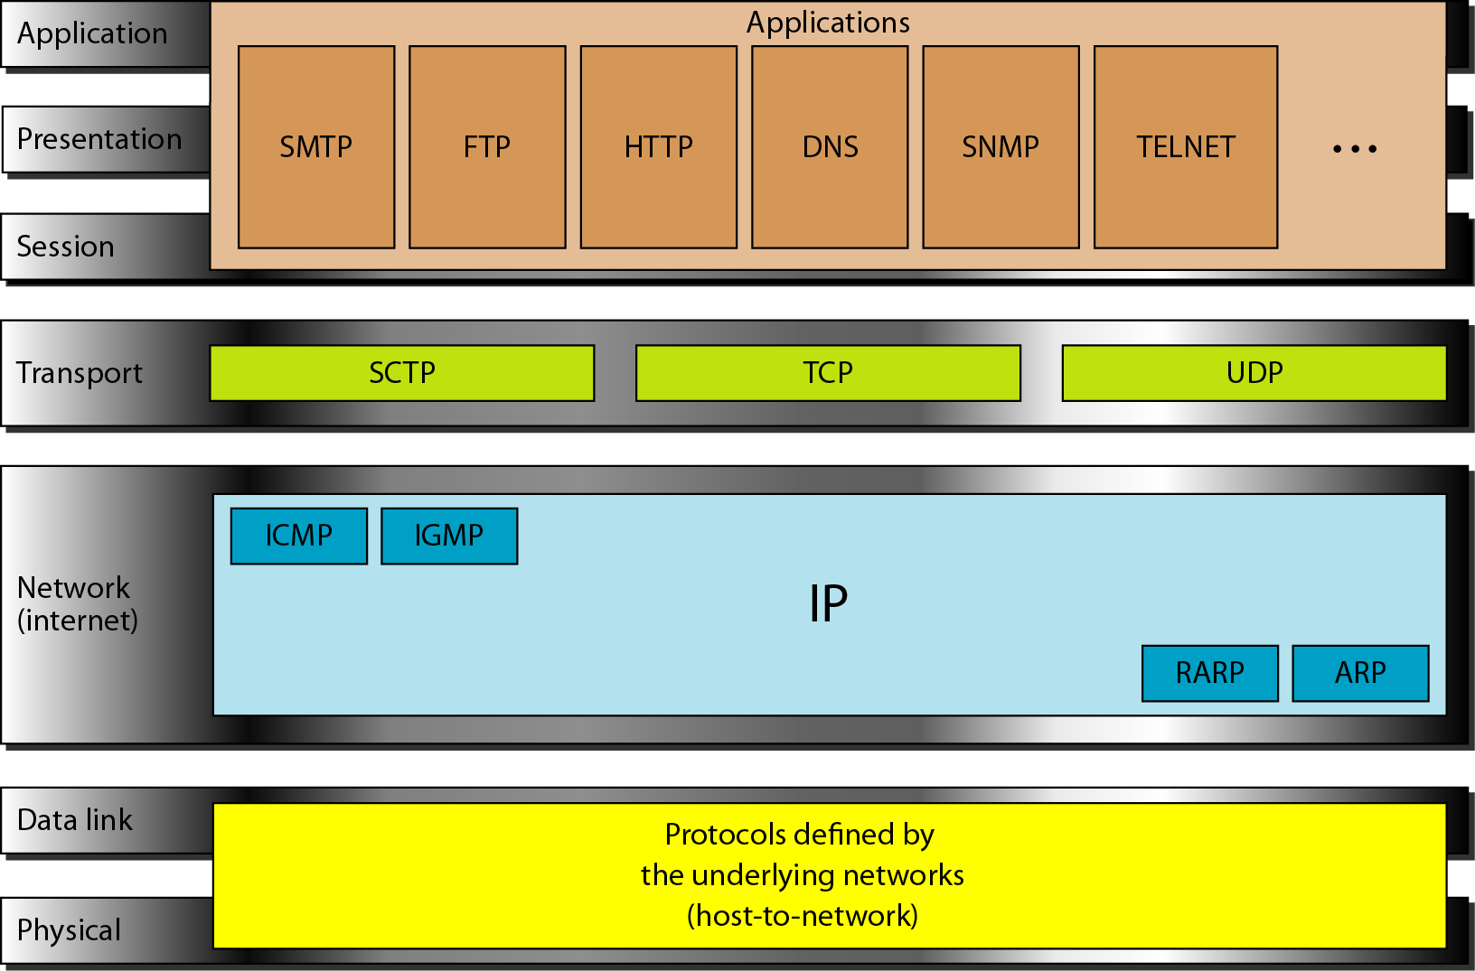
TCP/IP is a hierarchical protocol made up of interactive modules, each of which provides a specific functionality; however, the modules are not necessarily interdependent. Whereas the OSI model specifies which functions belong to each of its layers, the layers of the TCP/IP protocol suite contain relatively independent protocols that can be mixed and matched depending on the needs of the system. The term hierarchical means that each upper-level protocol is supported by one or more lower-level protocols.
At the transport layer, TCP/IP defines three protocols: Transmission Control Protocol (TCP), User Datagram Protocol (UDP), and Stream Control Transmission Protocol (SCTP). At the network layer, the main protocol defined by TCP/IP is the Internetworking Protocol (IP); there are also some other protocols that support data movement in this layer.

Slide 16
Physical and Data Link Layers
At the physical and data link layers, TCPIIP does not define any specific protocol. It supports all the standard and proprietary protocols. A network in a TCPIIP internetwork can be a local-area network or a wide-area network
Layer 1: Host-to-network Layer
Lowest layer of the all.
Protocol is used to connect to the host, so that the packets can be sent over it.
Varies from host to host and network to network.

Slide 17
Network Layer
At the network layer (or, more accurately, the internetwork layer), TCP/IP supports the Internetworking Protocol. IP, in turn, uses four supporting protocols: ARP, RARP, ICMP, and IGMP. Each of these protocols is described in greater detail in later chapters
Internetworking Protocol (IP)- is the transmission mechanism used by the TCP/IP protocols. It is an unreliable and connectionless protocol-a best-effort delivery service. The term best effort means that IP provides no error checking or tracking. IP assumes the unreliability of the underlying layers and does its best to get a transmission through to its destination, but with no guarantees. IP transports data in packets called datagrams, each of which is transported sepa• rately. Datagrams can travel along different routes and can arrive out of sequence or be duplicated. IP does not keep track of the routes and has no facility for reordering data• grams once they arrive at their destination. The limited functionality of IP should not be considered a weakness, however. IP provides bare-bones transmission functions that free the user to add only those facilities necessary for a given application and thereby allows for maximum efficiency.
The Address Resolution Protocol (ARP) is used to associate a logical address with a physical address. On a typical physical network, such as a LAN, each device on a link is identified by a physical or station address, usually imprinted on the network interface card (NIC). ARP is used to find the physical address of the node when its Internet address is known.
Reverse Address Resolution Protocol- The Reverse Address Resolution Protocol (RARP) allows a host to discover its Inter• net address when it knows only its physical address. It is used when a computer is connected to a network for the first time or when a diskless computer is booted.
The Internet Control Message Protocol (ICMP) is a mechanism used by hosts and gateways to send notification of datagram problems back to the sender. ICMP sends query and error reporting messages.
Internet Group Message Protocol(IGMP)- is used to facilitate the simultaneous transmission of a message to a group of recipients.

Slide 18
Transport Layer
Traditionally the transport layer was represented in TCP/IP by two protocols: TCP and UDP. IP is a host-to-host protocol, meaning that it can deliver a packet from one physical device to another. UDP and TCP are transport level protocols responsible for delivery of a message from a process (running program) to another process. A new transport layer protocol, SCTP, has been devised to meet the needs of some newer applications.
User Datagram Protocol (UDP)- is the simpler of the two standard TCPIIP transport protocols. It is a process-to-process protocol that adds only port addresses, checksum error control, and length information to the data from the upper layer.
Transmission Control Protocol(TCP) provides full transport-layer services to applications. TCP is a reliable stream transport protocol. The term stream, in this context, means connection-oriented: A connection must be established between both ends of a transmission before either can transmit data. At the sending end of each transmission, TCP divides a stream of data into smaller units called segments. Each segment includes a sequence number for reordering after receipt, together with an acknowledgment number for the segments received. Segments are carried across the internet inside of IP datagrams. At the receiving end, TCP collects each datagram as it comes in and reorders the transmission based on sequence numbers
Stream Control Transmission Protocol- The Stream Control Transmission Protocol (SCTP) provides support for newer applications such as voice over the Internet. It is a transport layer protocol that combines the best features of UDP and TCP.
Application Layer
The application layer in TCPIIP is equivalent to the combined session, presentation, and application layers in the OSI model. Many protocols are defined at this layer. We cover many of the standard protocols in later chapters.

Slide 19
Application layer
The application layer in TCP/IP is equivalent to the combined session, presentation, and application layers in the OSI model. Many protocols are defined at this layer. We cover many of the standard protocols in later chapters.
TELNET is a two-way communication protocol which allows connecting to a remote machine and run applications on it.
FTP(File Transfer Protocol) is a protocol, that allows File transfer amongst computer users connected over a network. It is reliable, simple and efficient.
SMTP(Simple Mail Transport Protocol) is a protocol, which is used to transport electronic mail between a source and destination, directed via a route.
DNS(Domain Name Server) resolves an IP address into a textual address for Hosts connected over a network.
It allows peer entities to carry conversation.
It defines two end-to-end protocols: TCP and UDP
TCP(Transmission Control Protocol): It is a reliable connection-oriented protocol which handles byte-stream from source to destination without error and flow control.
UDP(User-Datagram Protocol): It is an unreliable connection-less protocol that do not want TCPs, sequencing and flow control. Eg: One-shot request-reply kind of service.

